Slide 1
Conundrum
How can you make the most money, taking the least risk (w/o cheating)?
If high IR then low capacity
If you want capacity, you need to have liquidity and time to push capital in the market but then we will be subject to market volatility and hence degrade your IR
You will pay a fat Bid/Offer spread
You will be pushing the market in front of you – market impact

Slide 2
Sources of Alpha in an efficient market by J. Loeys
Quantitative techniques are indispensable, though, to deal with the complexity of financial instruments and the overload of information we face. Empirical evidence counts for more than theory, but you need theory to constrain empirical searchers and avoid spurious correlations

Slide 3
Sources of Alpha in an efficient market by J. Loeys
This is not to say that flow and position data are useless. We instead find that more detailed understanding of how different types of investors, each with their own restrictions and objectives, interact with the plumbing of the system, has allowed us to make better investment decisions.

Slide 4
Sources of Alpha in an efficient market by J. Loeys
The Theorem of Market efficiency assumes frictionless markets. Hence, cross-sectionally, we need to focus on areas where there are frictions due to different regulations, business practices, or investment objectives. Most profitable for me have been differences between currencies

Slide 5
Sources of Alpha in an efficient market by J. Loeys
Trade the risk bias. Even when markets price in exactly our modal views, I find it useful to consider how prices will move on new information and then try to position on any skew in the outlook. If I find that a particular price or spread will move a lot more on bullish than on bearish news, then I will position bullishly. This works at the portfolio level if I can combine different unrelated risk biases

Slide 6
Sources of Alpha in an efficient market by J. Loeys
Is there now so much information that everyone sees at the same time that alpha is dead? To some extent, yes, as reflected by the inability of the hedge fund world to offer better returns than a simple bond and equity portfolio with the same volatility over the past 10 years. Still, while alpha is weaker, I don’t think it is truly dead even as it seems harder to earn alpha within asset classes

Slide 7
A Lasting Alpha
A lasting alpha is obtained when the alpha is anchored/derived from structural market features or difficult to copy/create competitive advantages

Slide 8
Structural Market Features
Central Bank rate policies which can be set to “artificial” levels for long periods of time for marco economic purposes
think of a Carry Trade
Risk premia which can be collected from selling protection to market participants – risk needs to diversified away
Benefiting of market impact from large transactions or from broad market participation
think of M&A’s and retail business
Regulations

Slide 9
Competitive Advantages
IT – very expensive and growing
Credit – cost of capital and not portable
Information
either legal as a Market Maker or illegal as Insider Information

Slide 10
Be aware
Think hard about your ability to make money – is it legal?
Collusion
Insider Information
Trading before a client
Manipulation

Slide 11
An Algorithmic Trading Platform
Five modules define an algoritmic trading platform
An Alpha Engine(s)
An Order Generator
An Execution Engine
A Controller/Limit Server
A Management Module

Slide 12
An Algorithmic Trading Platform...
Each module has a clear functional purpose – some of these modules can have several instances

Slide 13
Management Module
Alpha Engines
Order
Generator
Execution
Engine
Controller
Limit Server
markets
parent orders
markets
inputs
signals
child orders
positions
fills
inventory – back office -- fills

Slide 14
The Alpha Engine(s)
This embodies your strategy, or your alpha, usually in the form of a program
It is where your (most valued) intellectual property (IP) resides – protect it well as it is your lifelihood
Depending on the needed speed of signal generation and the mass of data to process, your algorithm can be coded in Excel (not recommended), C#, Java, Python, MathLab, C++....

Slide 15
Alpha engines...
Inputs to the alpha engines are:
Live prices – you decide on the sampling speed
Other live variables – implied vols, flow data, economic numbers,...
A set of parameters to configure your alpha-generating algorithms
Output of the alpha engine(s) to the Order Generator are:
Live Signals – you decided on either a clock (ie time-based generation) mechanism or a price mechanism
In all cases, your output is either Long, Short or Flat for a given asset

Slide 16
Assets
An asset is a financial object for which you can collect and receive live the inputs you require
Such asset can be: Gold, 2-year US Swap Rate, Oil, Eur/Usd, SP500, Amazon
You will trade these assets -- for Gold as the current gold future (or the Cash), for the 2-year swap rate as the 8 first eurodollar futures or as an actual 2-year swap, for Oil as the current oil future, for Eur/Usd as Cash or Eur current futures, SP500 as the SP500 Index, an ETF or the SP futures, .....

Slide 17
Assets....
An asset can be a composite asset such a spread of 2 assets, a butterfly of 3 assets, a basket of assets....
Your signal refers to this asset (either real or composite)
Your alpha-generating algo manipulates such an asset
Your signal message coming from the Alpha Engine(s) is time-stamped (date/time to msec), carries a Long/Short/Flat signal, and holds a theroretical price for your asset
The theoretical asset price should incorporate the estimated cost of transaction for your size and credit

Slide 18
Assets ...
You should have enough info in the output (signal) message so that you can independently and asynchronously compute the usual stats for a strategy

Slide 19
Alpha Processor
The Alpha Processor (AP) module receives from the alpha engines (AE) a set of signals
For given alpha and asset, the signal is be Long, Short or Flat
The AP looks up the Allocation Table which gives for a given alpha and asset a quantity X to be traded
X is expressed as a function of the asset
X can be a number of lots (shares), a number of millions (of a base currency in Fx) or a number of Futures
The AP looks up what is currently in inventory for this alpha and asset

Slide 20
Alpha Processor ...
The AP then computes the diff (difference) between what is in inventory and what should be now in inventory based on the newly coming signal
This delta is then the notional of the order to be executed in the market in response to the newly generate signal message

Slide 21
Alpha Processor ....
signal | allocation | inventory | order
Long | X | +y | X-Y
Long | X | -Y | X+Y
Long | 0 | -Y | Y
Flat | X | 0 | 0
Flat | X | Y | -Y
Flat | 0 | 0 | 0
Short | X | Y | -X-Y
Short | X | 0 | -X
Short | 0 | -Y | Y

Slide 22
Alpha Processor ....
In general, an order (if any) is genetared with for notional
Signal*(X-Y)
Where Signal is +1 if Long, 0 if Flat and -1 if Short
X is allocated notional – always postive
Y is the current inventory, expressed in the same unit as X. Y is signed. A negative number reflects a short position in the asset in inventory, a positive number a long position in inventory
Once Order(s) executed then Inventory in absolute term should be no more than X

Slide 23
Limit Server
(Some) Risks associated w/ electronic automatic execution
Run-away system
Oscillating system
Over-sized trades

Slide 24
Protection and Limits
Limit on number of trades over a short and a long period of time
Limit on volume traded over a short and a long period of time
Limit on outrigt position acquired at any given time
Limit on negative PnL experienced over a short and long period of time

Slide 25
Protection and Limits (continued)
What are the short and log periods of time
typically and it will depend of your algo
but lets assume a short period to be a few minutes
and a long period a few hours

Slide 26
Monitoring, Alerts and Alarms
A run-away system is a system which issues constantly and quickly and wrongly a large number of orders
One reason can be a endless loop in the Alpha Processor
Another reason can be that the executed order (filled) does not make it to your inventory system at all or in a timely fashion and therefore your system does not find the inventory upda

Slide 27
An Oscillating System
An oscillating system – buy and sell occur one after the other (endlessly...)
This can be due to rounding error or an inadequate treatement of threshold – there is the need of a buffer (which at least should reflect the b/o spread cost)
It also can be due to a system auto-correcting

Slide 28
Steps to protect from abnormal catastrophic behaviors
Fixed notional for orders
Fire and Forget
No auto correction – if there is an issue – stop trading and investigate
Trading on a clock (not always possible) and not on a price – as all your algos and alphas may end up trading at the same time, pushing the market and concentrating your risk

Slide 29
Execution Engine(s)
It is where the tire hits the road
Translate the asset in a tradeable instrument
Choice of a venue
Always trade markeable limit orders (never a Market Order you would be taken for a expensive ride)
Choice of an instruments – Mini Futures vs Futures, Futures vs a Swap
Be aware of market hours and holidays
Be aware of liquidity – measure current B/O spread for your size and credit and compare it to an history of such observed values

Slide 30
Execution Engine(s)
Place Limit Order
Several types – FOK (fill or kill)
Limit orders w/ SHORT time to expiry
Do not stay in the market too long
You may decross – for instance executing Usd/Cad and Usd/Mxn is cheaper than to execute Cad/Mxn
You may execute your basket of asset in parts
Be careful of the dangers of “leg it in”
Try to stay locally market neutral
Do not do the easy leg first

Slide 31
Execution Engine(s)
Aggregate Liquidity to get best possible B/O spread
Place resting orders if market not moving – turn yourself into an opportunistic market maker
You may be able to trade a proxy – cheaper or available. Think of a Dax position which is not tradeable from 4pm to 2 am while the S&P is moving. What will happen when the Dax re-open 8 hours later. It will be moving about the same as of the S&P
Maybe you should convert (or hedge) your Dax into an SP (proxy) position during that time period

Slide 32
Execution Engines
You may have some HF algorithms which monetize market microstructures as you work your (large) order
Order book imbalances
Decrossing
Trading cheaper proxy in place of your actual desired instrument
Local mean reversion
Leading vs lagging assets

Slide 33
Operational Risk of a System
Fully automated
risk
new
release
time

Slide 34
Operational Risk of a System
Implemented with a human component
risk
launch
time

Slide 35
Checking on validity of a strategy
Needs to be rooted in a structural trait of the market
What happens when parameters are slightly modified? Is it a nice dome? Or a jagged profile?
Did you optimize? You should not
What happened of you delay your signal by 1, 3, 5 10, 30 minutes – persistence of your alpha
What happened if you double, triple, .... the B/O Spread that you are using
Never work w/ mid prices – you are wasting your time and your employer/investors money

Slide 36
Allocation of capital to a set of strategies
A few cautionary comments:
Strat w/ 2 or 3 stages is a weak strategy – one stage is the optimal neither the preceding nor the following
Equi-allocation for asset of same vol magnitude
Be careful of assets w/ very low vol – is it a “managed” asset such as a pegged ccy?

Slide 37
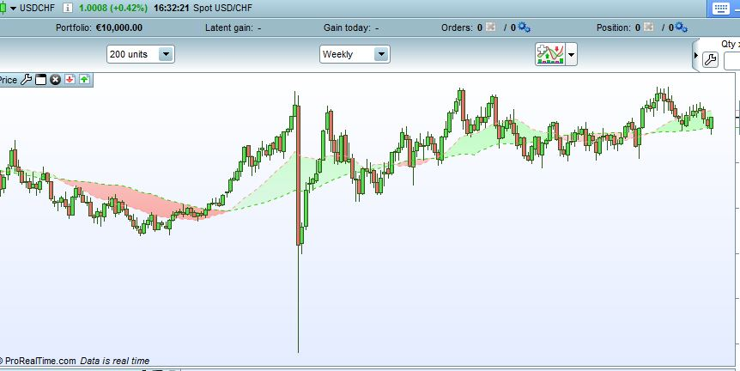
Allocation of capital to a set of strategies
What will happen when the managed asset is not managed anymore

